Slide 1
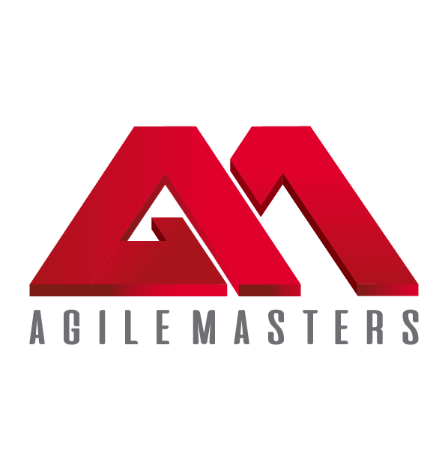
Improving Career Prospects & Workforce Productivity!
AGILE MASTERS INC.
WWW.AGILEMASTERS.ORG

Slide 2
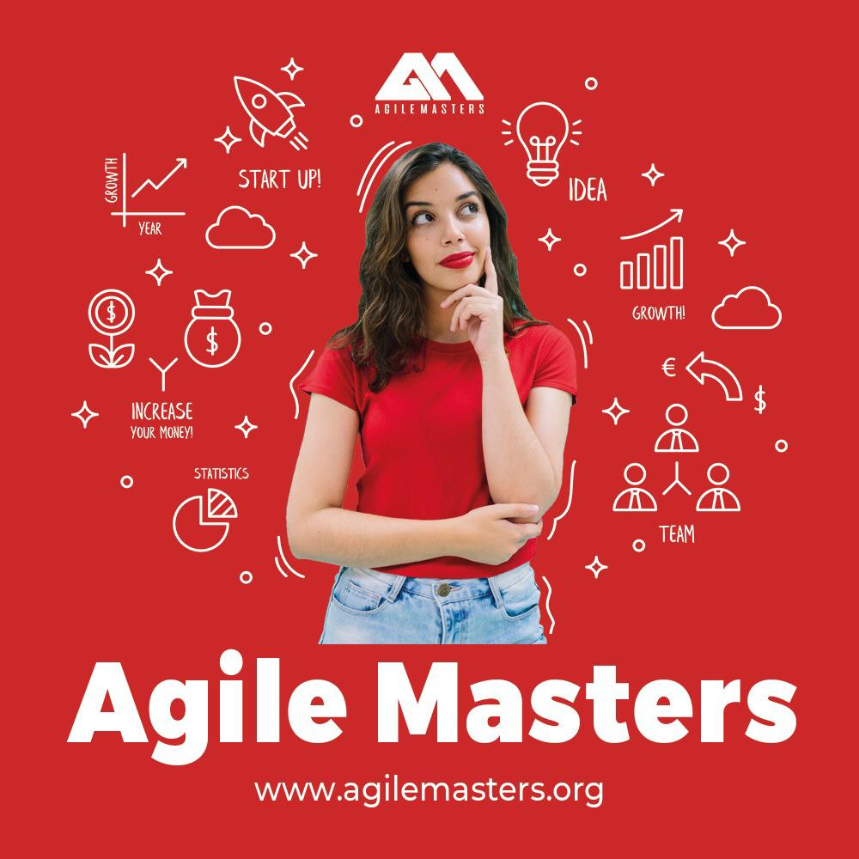
AGILE MASTERS is simply an online & in-person professional training platform that empowers individuals, teams, and organizations with Agile expertise to deliver transformative solutions, support organizational agility, enhance individual productivity, and drive industry growth.
Explore the power of AGILITY
and take advantage of the Agile Masters Online Opportunities with diverse professionals!
WWW.AGILEMASTERS.ORG
…adding value to individuals & organizations!
2

Slide 3
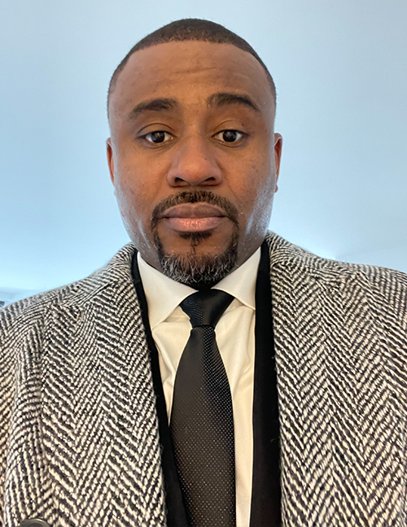
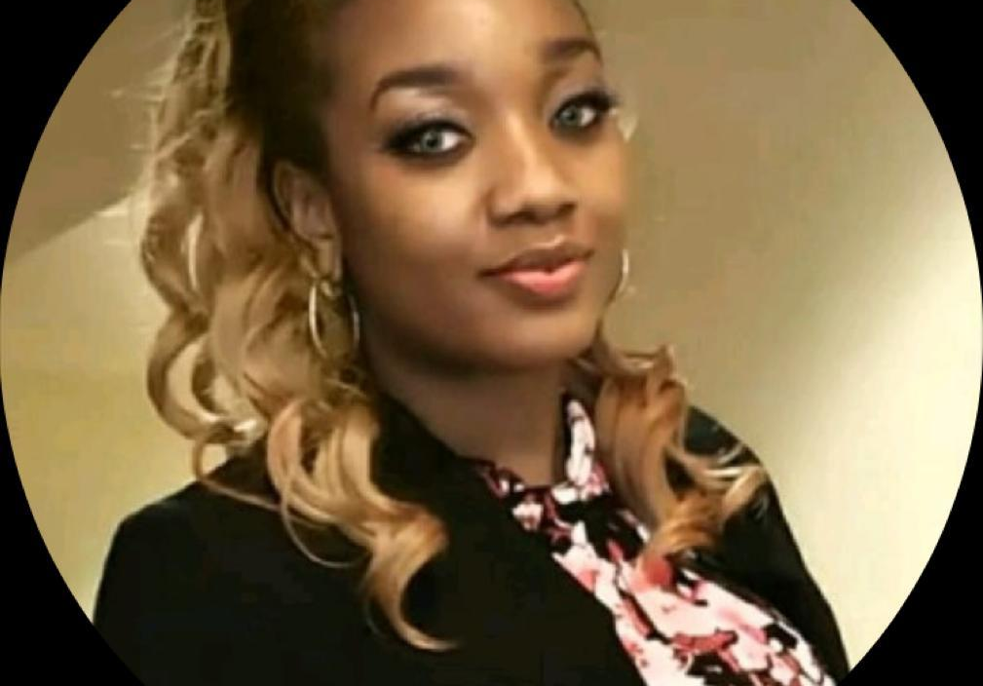
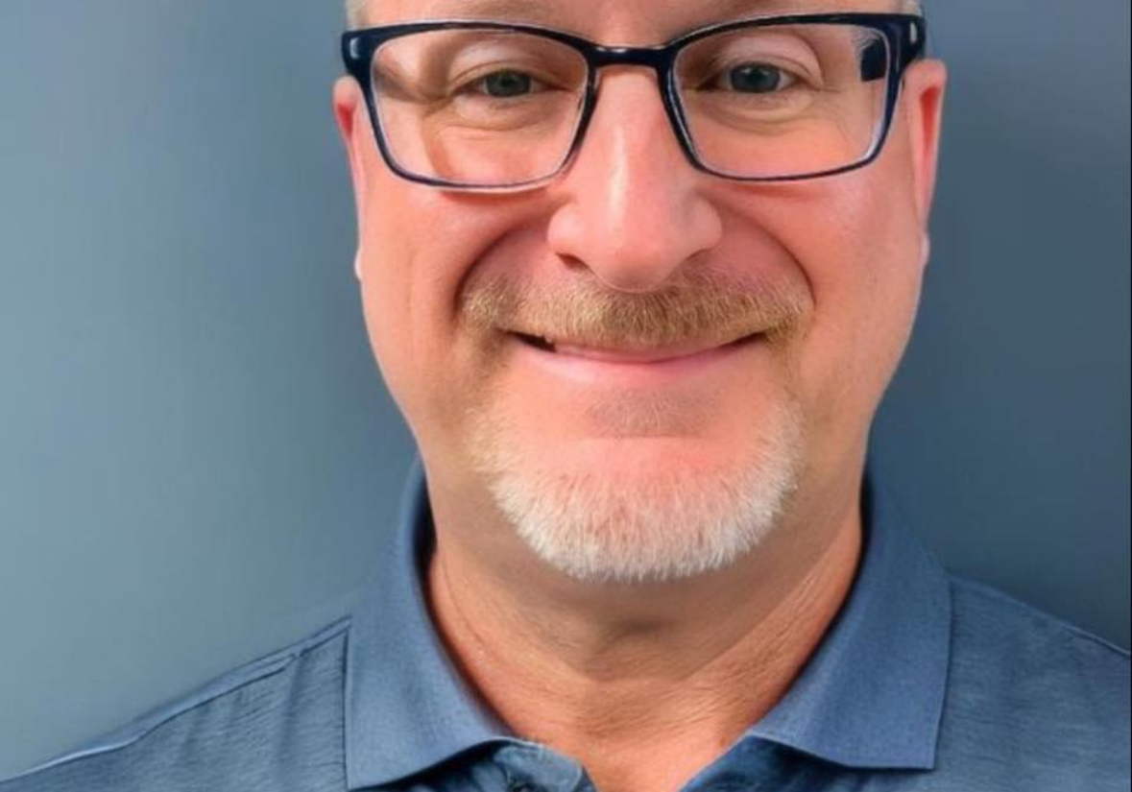
MEET OUR TEAM
Festus a. otabor
Administrator
Beluchi brown
JerEmiah agboiyi
Organization Agility Coach
Agile Transformation Coach
Gary montgomery
Team Support Coach
Visit:
www.agilemasters.org/instructors for more details.
3
Notes:
Note: Insert your picture by clicking on the Picture Place Holder Icon, then send it back!

Slide 4
ACCREDITATION PARTNERS
AGILE MASTERS currently Partners with two major Agile
Globally Accredited Licensing institutes i.e.,
# SCRUMstudy™-VMEdu® which has:
- 2100+ Partners with Employees from 3500+ Companies.
- Certified Over 1,000,000 Professionals in 150+ Countries.
- 7,500+ SCRUMstudy™-VMEdu® Certified Students Monthly
[More than any other Certification Body - as seen on the graph]
# SCALED AGILE INC. - SAFe® [Scaled Agile Framework]:
- The world’s most Trusted System for Business Agility.
- Adopted by more than 20,000 Enterprises Globally.
- Over 1,000,000 Practitioners Trained.
- Supported by more than 500 World-class Transformation
& Platform Corporations in 110+ countries.
[AGILE MASTERS remains ONLY Partner with Robust System
that practically manages its student’ continuous learning - ]
WWW.AGILEMASTERS.ORG
4
Notes:
Note: Insert your picture by clicking on the Picture Place Holder Icon, then send it back!

Slide 5
AGILE MASTERS
REQUEST SUMMARY
WWW.AGILEMASTERS.ORG
The AGILE Masters Training and Certification Program is set to equip Organization Workforce | Executive Leaders with related Agile skills to effectively lead and manage diverse industry sector.
To support the Global Agile Transformation Drive, we request that your organization endorses the Agile Masters Training & Certification Program for its Executives/Management/Staff—covering the Leading SAFe [Certified SAFe Agilist ] and SAFe Product Owner/Product Manager Course. This drive is designed to leverage on some established regional subsidy to considerably lower the financial cost implication.
Affixed cost of the training
per official is $975.00 and
Agile Masters offers a regional 60% subsidy waiver for All your respective personnel. While your organization further secure payments to cover the balance 40% toward getting the program available for its respective personnel or have them pay the balance of $390 each for the respective course, as deem fit.
5
Notes:
Note: Insert your picture by clicking on the Picture Place Holder Icon, then send it back!

Slide 6
Program structure
Training course modules
Accreditation process
The SAFe Agilist | PO/PM Course:
This consist a 4-session [3-hours each] Instructor-led live-class training with 1-hr Q&A per session | total of 4-hour follow-up | access to self-study material, exam scheduling, and certification upon passing exam.
This includes access to continuous learning support from instructors & other Agile Experts via the Agile Masters Discourse Platform.
[plus Applicable Coaching Support].
Affixed cost of the training per official is $975.00 and Agile Masters has secured a waiver of 60% for all your respective officials.
Instructor-led Live Classes:
Attend the instructor-led live classes, and
receive initial Certificate of Participation
Covering 2-Continuing Education Unit.
Professional Self-study/Exam/Certification:
Gain access to the advance course materials
and exam scheduling for a more professional accreditation from the Agile Masters Accreditation Institute.
Continuous Professional Development:
Access Agile Masters 24/7 interactive live
coaching support platform for tackling daily challenges, increase productivity, lead effectively, and boost/improve workplace
confidence.
THE COST
[$975 LESS 60% WAIVER]
$390 ONLY!
6
WWW.AGILEMASTERS.ORG
Notes:
Note: Insert your picture by clicking on the Picture Place Holder Icon, then send it back!

Slide 7
BENEFITS TO the ORGANIZATION?
5. Scalability –
• Leading SAFe: Provides knowledge & tools to scale Agile practices across the organizations.
• SAFe POPM: Support scalable product/service management to aligned with business growth.
6. Risk Management & Quality –
• Leading SAFe: Reduces operation risks/failures while maintaining high quality standards.
• SAFe POPM: Prioritizes operations based on business value and risk for better outcomes.
7. Customer Satisfaction –
• Leading SAFe: Enhances responsiveness to customer needs toward improving satisfaction.
• SAFe POPM: Ensures timely delivery of product /services that meet market expectations.
8. Employee Engagement & Satisfaction –
• Leading SAFe: Empowers employees with work autonomy & ownership, increasing job satisfaction.
• SAFe POPM: Enhances team and operations management, leading to positive work environment.
9. Compliance & Governance –
• Leading SAFe: Ensures compliance with industry standards while staying Agile.
• SAFe POPM: Aligns product/service operations processes with legal and regulatory requirements.
1. Business Alignment –
• Leading SAFe: Aligns team objectives with broader business goals, ensuring strategic focus.
• SAFe POPM: Equips Administrators/Managers to best prioritize and manage operation backlogs in alignment with organizational goals.
2. Productivity & Efficiency –
• Leading SAFe: Implements Lean-Agile principles to streamline processes and reduce waste with faster delivery times.
• SAFe POPM: Focuses development efforts on high-value tasks, improving efficiency.
3. Collaboration & Communication –
• Leading SAFe: Enhances collaboration across teams and departments with a unified Agile framework toward productive work-environment.
• SAFe POPM: Improves communication between Administrators/Managers, and operation teams, ensuring sync with corporate goals.
4. Innovation –
• Leading SAFe: Fosters continuous improvement and adaptation to market changes.
• SAFe POPM: Helps Administrators/Managers drive innovation by understanding customer needs and trends to drive better innovation.
WWW.AGILEMASTERS.ORG
Notes:
Note: Insert your picture by clicking on the Picture Place Holder Icon, then send it back!

Slide 8
BENEFITS TO the PERSONNEL?
1. Career Advancement:
Equips the organization workforce with sought-after Agile leadership and management skills, enhancing career growth and opportunities for advancement.
2. Enhanced Leadership:
Improves leadership capabilities, enabling individuals to lead teams more effectively and align their work with business goals.
3. Increased Efficiency:
Trains personnel in Lean-Agile principles, helping them to work more efficiently, manage tasks better, and deliver results faster.
4. Stronger Communication:
Develops skills in clear communication and collaboration, improving teamwork and reducing misunderstandings.
5. Innovation Skills:
Encourages a mindset of continuous improvement, empowering individuals to drive innovation and adapt to changes in the market.
6. Scalability Knowledge:
Provides the ability to manage and scale Agile practices effectively, making individuals more valuable as their organization grows.
7. Risk Management Expertise:
Enhances the ability to identify and manage risks, leading to better decision-making and higher-quality outcomes.
8. Job Satisfaction:
Increases autonomy and ownership over work, leading to greater job satisfaction and a more fulfilling career.
These in general improves their leadership, efficiency, and overall job performance, benefiting both the individual personnel
and the organization.
WWW.AGILEMASTERS.ORG
8
Notes:
Note: Insert your picture by clicking on the Picture Place Holder Icon, then send it back!

Slide 9
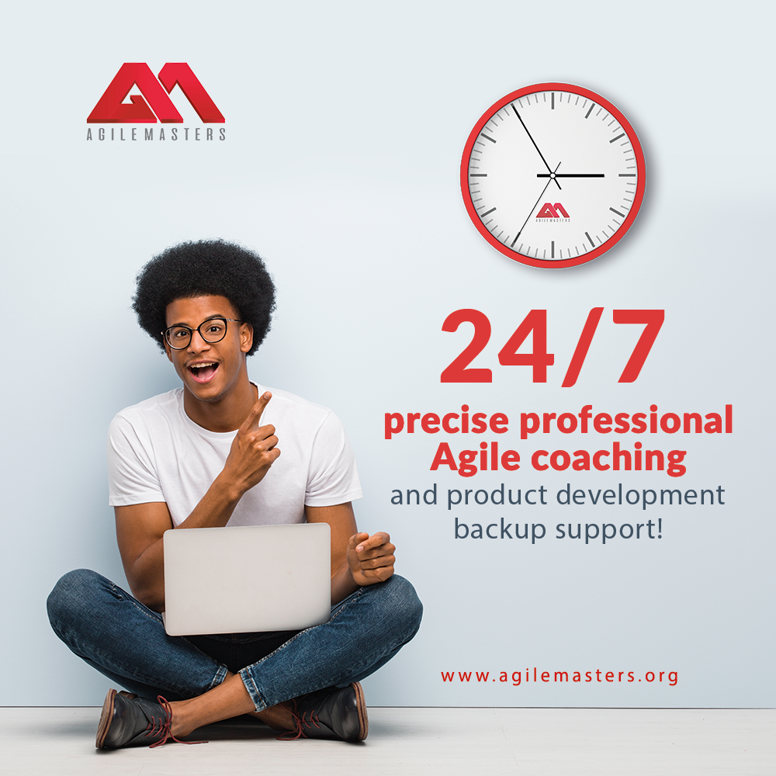
BENEFITS TO the country?
1. Economic Growth:
By enhancing the skills and efficiency of personnel, these certifications contribute to higher productivity and innovation within organizations, which in turn boosts the overall economy.
2. Global Competitiveness:
Certified professionals help organizations adopt Agile practices that improve responsiveness to market demands, making the country’s industries more competitive on a global scale.
3. Workforce Development:
These programs equip individuals with modern management and leadership skills, fostering a more skilled and adaptable workforce that can drive national development.
4. Innovative Ecosystem:
Encouraging a culture of continuous improvement and innovation within organizations helps to create a more vibrant and innovative business environment across the country.
5. Job Creation:
As organizations become more efficient and grow, they get to create more jobs, contributing to lower unemployment and a stronger labor market.
6. Improved Governance & Compliance:
Professionals trained in these certifications bring better governance and risk management practices, which in turn lead to more ethical and compliant business practices across industries.
By fostering a more efficient, innovative, and competitive business environment, these certifications indirectly contribute to an overall development and prosperity of the country.
WWW.AGILEMASTERS.ORG
13
Notes:
Note: Insert your picture by clicking on the Picture Place Holder Icon, then send it back!

Slide 10
JOIN us
In this Agile Transformation Drive…
As We Get Every Corporate Workforce
AGILE SAVVY & Certified!
+1 [332] 249-7355 | +234 [916] 326-8690 agilemasters.org@gmail.com | www.agilemasters.org
Level 85 – One World Trade Center, New York – NY 10007
WWW.AGILEMASTERS.ORG
Notes:
Note: Insert your picture by clicking on the Picture Place Holder Icon, then send it back!

